Slide 1
Secure data hiding in images using steganography
Presented by : Swati Shamlal Dube
Student Name : Swati Shamlal Dube
College Name : Shatabdi institute of engineering, agaskhind,Nashik
Department : Computer Engineering

Slide 2
OUTLINE
Problem Statement
Technology used
Wow factor
End users
Result
Conclusion
Git-hub Link
Future scope

Slide 3
Problem Statement :
With the rise of digital communication, ensuring secure and covert transmission of sensitive information has become a challenge. Traditional encryption techniques make encrypted messages obvious, drawing unwanted attention. To counter this, develop a steganographic system that can embed confidential text messages within everyday multimedia files (such as images, audio, or video) in a way that is indistinguishable from normal content. The system should prioritize minimal distortion, high embedding capacity, and robustness against common file modifications (e.g., compression or resizing). Additionally, implement a feature to detect and extract hidden messages efficiently while maintaining the integrity of the cover medium.

Slide 4
Technology used :
Libraries
Cv2
Operating system
Numpy
Platform
Windows 10

Slide 5
wow factors :
Multi-layered Steganography : Instead of hiding data in a single medium (like an image), use multiple layers (e.g., hide data in an image, then encrypt it inside an audio file). This makes detection much harder
Adaptive Steganography : Use AI/ML to analyze the cover medium (image, audio, video) and adaptively choose the best hiding technique to minimize distortions and avoid detection.
Interactive Steganography : Implement a feature where data extraction requires user interaction, such as solving a puzzle, scanning a QR code, or using biometric authentication.

Slide 6
End users :
Cybersecurity Experts – Hide sensitive data for secure communication
.2. Journalists & Whistleblowers – Conceal messages to avoid censorship.
3. Forensic Investigators – Retrieve hidden data for crime investigations
.4. Malicious Actors – Use it for covert data exfiltration or cybercrime

Slide 7
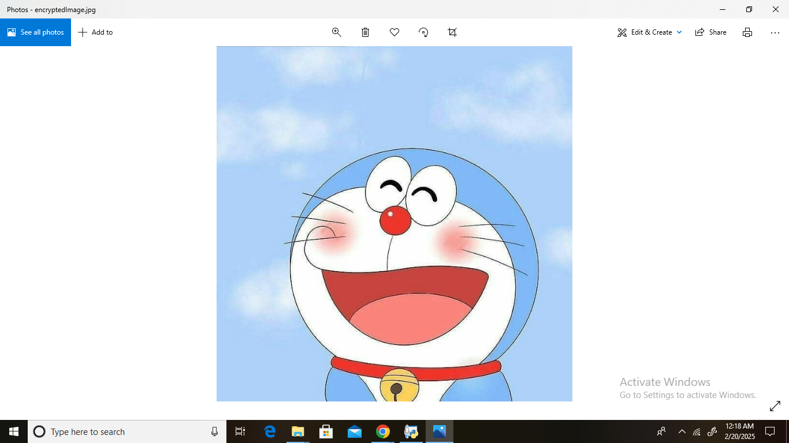
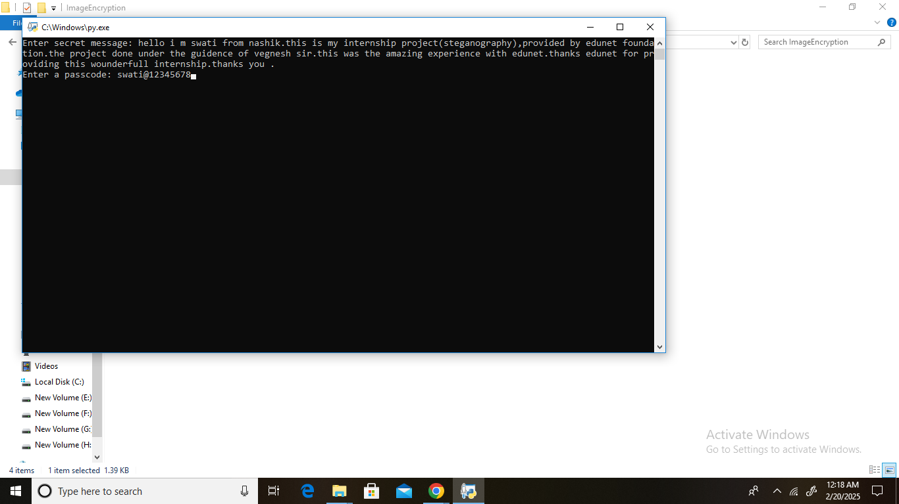
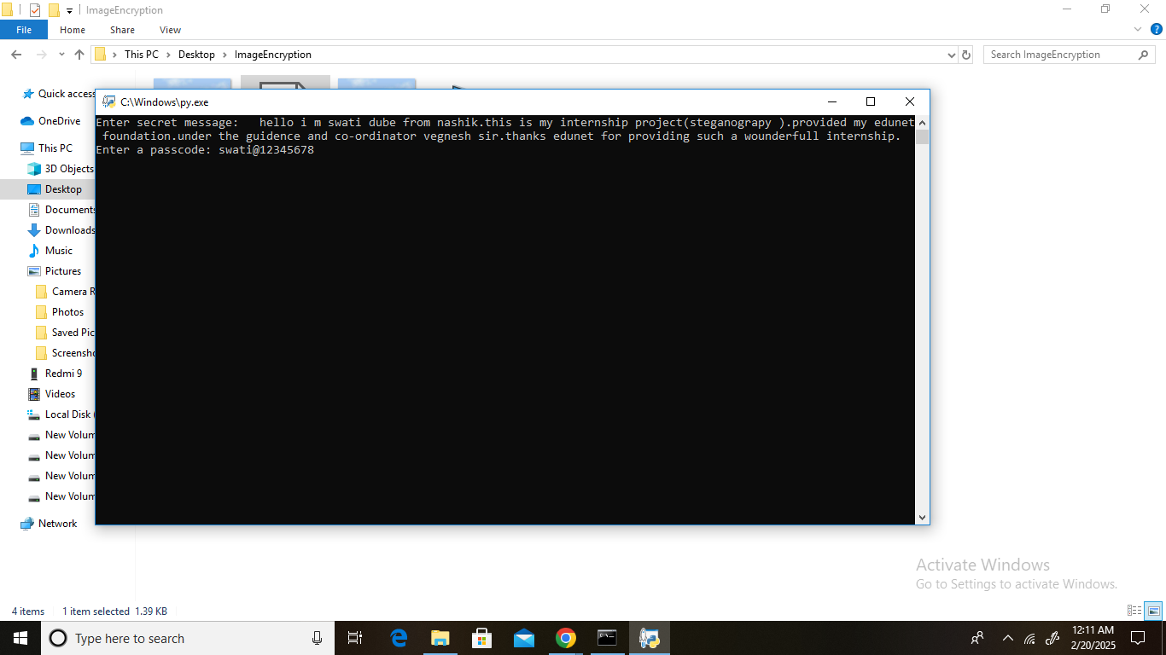
Results

Slide 8
Conclusion :
Steganography is a powerful technique for securely hiding information within digital media. It enhances privacy, supports cybersecurity, and has both ethical and unethical uses. While it provides secure communication, it also poses risks if misused. Responsible usage is key to balancing security and ethics.

Slide 9
GitHub Link
https://github.com/swati20037/encrypt.py.git

Slide 10
Future scope :
1 .Enhanced Cybersecurity – Advanced encryption with AI for secure data transmission.
2. Steganography in AI & IoT – Secure communication in smart devices and AI-driven networks.
3. Forensics & Digital Watermarking – Prevent digital piracy and authenticate media content.

Slide 11
THANK YOU

